Slide 1
Crave Casinos and Resorts
Sales Dashboard by Kaushik bandaru(1945699)

Slide 2
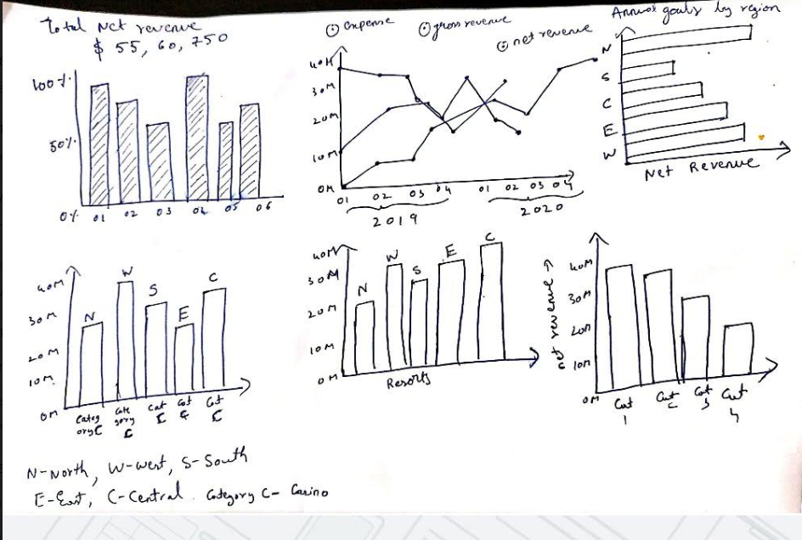
Rough Sketch of Dashboard
Notes:
This is a rough sketch made for the proposed dashboard. We can see the wireframe model in the next slide.
Created a bar chart to represent the total net revenue of Crave Casinos and Resorts.
Created a line graph to represent key financial such as (gross revenue, expenses, net revenue for two-year period by quarter..
Created a bar chart to represent net revenue vs region.(North , South, East, West)
Created a bar chart to the revenue for Casinos and Resorts against the region.
Created a bar chart to represent the customer category and their goals against revenue.

Slide 3
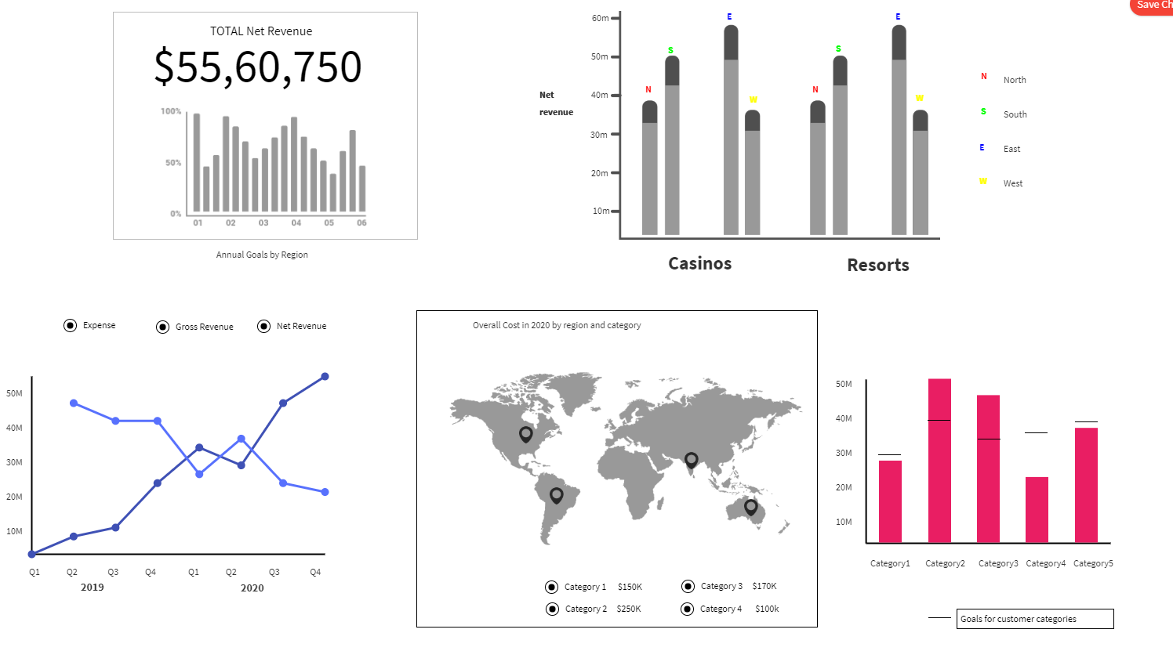
Wireframe Model for Dashboard
Notes:
This is the wireframe model for the Dashboard proposed:-
This model was drawn using the https:/wireframepro.mockflow.com site.
I have mentioned 5 visual charts in this dashboard
Graph A shows the overall net profit for the company as a whole towards the annual targets by region.
Graph B follows the criteria of the Chief Executive Officer (Tomas) who can pick a area and see the Casino/Resort ranking by net profit for the year. Graph C follows the expectations of the Chief Marketing Officer who wants to see net revenue vs. customer category goals.
Graph D fulfills the need of the Chief Financial Officer (Ratika) who has demanded a
tool to demonstrate the trend of core financial metrics over time (gross sales, expenditures, net income). Sh
e wants to see that for every quarter
for a span of two years.
This graph also satisfies VP of Sales need to view gross revenue by quarter of
the current year as compared with gross revenue by quarter of the previous year.
Here the radio buttons above the lines in the
line graph can be shown respectively by clicking and deleting.
Graph E is created for the Chief Operating Officer who wishes to understand to
consider the total costs of services by area and category this year and understand distribution of costs by area.

Slide 4
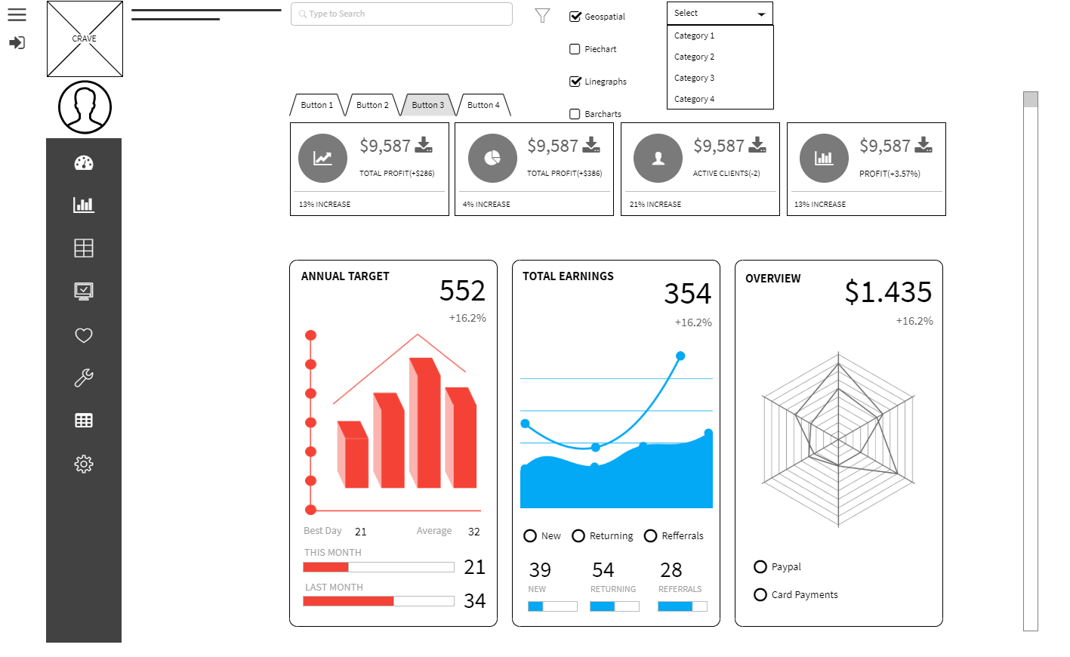
Draft Story Board of Dashboard
Notes:
This Dashboard is for the IT department. This is the Menu bar at the top where you can see the Net Income, Business Summary, Current Clients and the Annual Report.
We also have a menu bar on the left that has different Dashboard settings.
The questions encountered while the story board was being created are:-
Where all of the storyboard shortcuts are needed?
Is the storyboard easy to understand, or needs updating / changing.
Overview what roles are needed or not necessary?

Slide 5
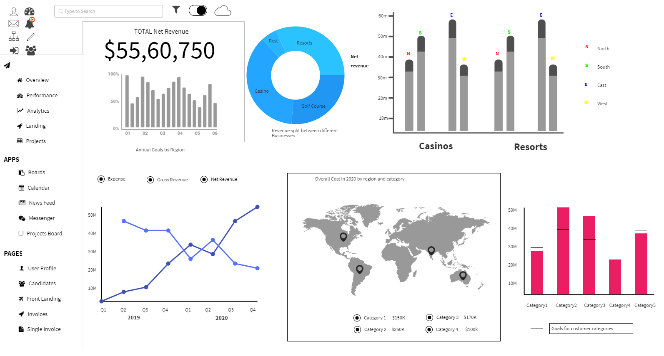
Mockup Dashboard
Notes:
Users can use different options from left panel to perform analytics or open other projects. There is also a messenger option where team members can interact. Piechart directly shows how revenue can be split based on business. Though this shows the same data as wireframe, these are the most important graphs as requested by team member. Hence, I added buttons and options to same wireframe.

Slide 6
Assumptions
The regions here to see Casino / Resorts are considered to be North, South, East, and West.
The term for overall costs was considered to be the division of Services.
We assume the firm's board members have a clear understanding of how the dashboard functions.
We presume that the data has been cleaned and is ready for display using the dashboard
We presume the simulation forms may be modified by the user according to his / her convenience.
Notes:
The concerns that were faced during the Dashboard design are:
How many people will use the Dashboard?
Will we need a dashboard for estimating revenue, net profit and expenses?
Do we need a dashboard to know which clients are profitable?
Should we add a function to the dashboard for risk analysis?
Will we need the users who will use the dashboard to sign in to?
What kind of graphical view do we need for dashboards (Ex: - Bar graphs, Pie charts, line graphs, etc.)?
To see how the expenses are being allocated, what regions or places will be displayed?

Slide 7
Suggestions to use Dashboard
The users should be given a short training or tutorial about how the dashboard works before using the dashboard.
Instead of making the dashboard too complex, only the necessary functions should be selected to view on the dashboard.
To build the dashboard, using user friendly software such as Power BI, Tableau, or Qlik Feel is feasible.

